Slide 1
RECORD MANAGEMENT
(KIC—CASE LAWS)
1 Govt Cir No DPAR 82 RTI 2007 dtd 21-08-2007andKIC 566 COM / KIC 603 COM 2006
(a) If a record is lost, try to reconstruct it.
(b) If a record is lost, register FIR with police after holding internal inquiry.
2 Govt Cir No DPAR 165 RTI 2007 dtd 28-03-06
If a record is destroyed, give endorsement to that effect.

Slide 2
……
    3) KIC 97 COM 2007 dtd 25-07-2007
    MD of HOPCOMS was fined Rs 500/- for not providing information about cataloging and indexing of records.
    4) KIC 171 APL 2007 dtd 28-09-2007
    KIC recommended DE for loss of records
    5) KIC 280 APL 2006 dtd 03-04-2007 and 08-10-2007
    PIO of TAPCMS not provided Receipts and vouchers
    KIC ordered compensation Rs 2000/-
    penalty Rs 1000/-

Slide 3
    PENAL CLAUSES
    RTI ACT 2005 (WEF 12-10-2005)
    CAUSES
    Information not provided
    Information delayed
    False / Incomplete information
    Refused to receive application
    Destroyed the information
    PENALTY
    Rs 250/- pd Max Rs 25000/-(sec 20)
    In some cases compensation to applicant
    sec 19 (8) (b)
    Recommend DE (Only SIC)

Slide 4
    KSPR ACT 2010 (WEF 22-11-2011)
    CAUSES
    Destroying Records (sec 8)
    Taking Records out of state (sec 4)
    PENALTY
    Imprisonment up to 5 years
    Fine up to Rs 25000/- or both sec 9
          ……………………………………

Slide 5
KARNATAKA STATE PUBLIC RECORDS ACT 2010
(WEF 22-11-2011)
Section 2(d) Definition of Record
“Public Record "includes
Any document, manuscript and file,
Any micro film, microfiche and facsimile copy of a document,
Any reproduction of image or images embodied in such microfilm, whether enlarged or not, and
Any other material produced by a computer or by any other device of any records creating agency

Slide 6
Section 3(2) Functions of the Director of State Archives
Supervision, management and control of the archives
Arrangement, preservation and exhibition of Public Records
Analyzing, developing, promoting and co-ordinating the standards, procedures and the techniques for improvement of the records management system,
Survey and inspection of public records
(q) Destroying or disposal of public records

Slide 7
Section 4 prohibition against taking of public records out of the state
Section 5 Records officer :- Every Records creating Agency shall nominate one of its officers as Records officer to discharge the functions under this act
Section 6 Responsibilities of Records officer
Section 7 Records officer to take appropriate action in the event of unauthorized removal destruction of Public Records
Section 8 Destruction or disposal of Public Records

Slide 8
Section 9 Penalty for contraventions
whoever contravenes any of the provisions of section 4 or section 8 shall be punishable with imprisonment for a term which may extend to five years or with fine which may extend to twenty five thousand rupees or with both

Slide 9
END
Section 13 Archival Advisory Board
Section 14 Functions of the Board
Section 15 Power of the Director to lay down
norms and standards for courses
in archival science
Section 16 Protection of action taken in good faith
Section 17 Power to make rules
Section 18 Power to remove difficulty

Slide 10
RECORD MANGEMENT
Obligations of public Authorities
Under RTI Act 2005 Every public authority shall
maintain all its records duly catalogued and indexed in a manner and the form which facilitates the right to information under RTI Act...

Slide 11
...obligations of public authorities(contd..)
..and ensure that all records that are appropriate to be computerized are , within a reasonable time
and subject to availability of resources, computerized
and connected through a network
all over the country on different systems
so that access to such records is facilitated; s.4(1) (a)
Ex:- Secretary- Moraba.-GP-Kudligi. Tq, Bellary Dt.

Slide 12
RTI SECTION 4(1)(a)
means
Record management
Classification, Indexing, & Cataloging

Slide 13
Stages of a Record
Creation
Classification
Maintenance
Preservation
Destruction

Slide 14
Types of Records
Current Records
Closed Records
Records meant for Destruction

Slide 15
Maintenance of Current Records
Five Bundle System
Papers Received
Periodicals
Await files
Circular Files
Records to be sent to Record Room

Slide 16
FIVE BUNDLE SYSTEM
CASE WORKER’s ALMIRAH
Papers Received | Periodicals
Await files | Circular Files
Await files | …….
Records to be sent to Record Room | …….

Slide 17
Maintenance of Closed Records
Preservation Period
‘A’ Disposal - permanent - Red cloth
‘B’ Disposal - 30 years - Green cloth
‘C’ Disposal - 10 years - Yellow cloth
‘D’ Disposal – 1 year - Blue cloth
Approving authority
‘A’ Disposal ………..Head of the Department
‘B’ Disposal……………Group A officer
‘C’, ‘D’ Disposal……..Group B officer

Slide 18
LABEL ON A CLOSED RECORD
Office----------------------
DIS year
INDEX
YEAR OF DESTRUCTION
Record Number---------------
Subject -------------------------
Opening of File----------------
Closing of Record-------------
Number of Pages -------------
Linked files No----------------
Signature of CW Signature of RK

Slide 19
Assignment of Disposal to Closed Records
(Para No 92 of Hand Book of Office Procedure)
General Receipt Register ‘D’ dis
Periodical Register ‘E’ dis
Dispatch Register ‘d’ dis
Attendance Register ‘E’ dis
Stamp Register ‘D’ dis

Slide 20
ASSIGNMENT OF DISPOSAL OF CLOSED RECORDS
(Art 399 of KFC—Financial Records)
Pay Acquaintance Rolls 40 years
Cash Book 20 years
Cg Register 5 years
Bill Register 5 years
Remittance Register 10 years
Counter Foils of Receipt Books 6 years
Sub vouchers 3 years
OTHER RECORDS
As in previous slide

Slide 21
RECORD ROOM
RACKS ARRANGEMENT
EST Year NO | Wise wise
TRG
ACT
MISC
EST Year NO | Wise wise
TRG
ACT
MISC
EST Year No | Wise Wise
TRG
ACT
MISC
EST Year NO | Wise wise
TRG
ACT
MISC
EST Year NO | Wise wise
TRG
ACT
MISC

Slide 22
‘D’ disposal with case worker
RECORD ROOM
RACKS ARRANGEMENT
EST ‘A’ Dis YEAR WISE
‘B’ Dis YEAR WISE
‘C’ Dis YEAR WISE
TRG
ACT
MISC
COMP

Slide 23
Destruction of Closed Records
Disposal as waste paper ( cut into pieces)
Burning
Maintain a Record of Destruction of closed Records

Slide 24
Registers to be Maintained in the Record Room
Record Register – Para 72 –Form No XI
Record Issue Register – Para 79 – Form No XIII
Requisition Slip – Para 78 – Form NO XII

Slide 25
FORM XI
(PARA-72)
RECORD REGISTER
---------------------------------------------------------------------- SL No.. Case No Index Title/sub Initials of RK
----------------------------------------------------------------------
1 2 3 4
---------------------------------------------------------------------

Slide 26
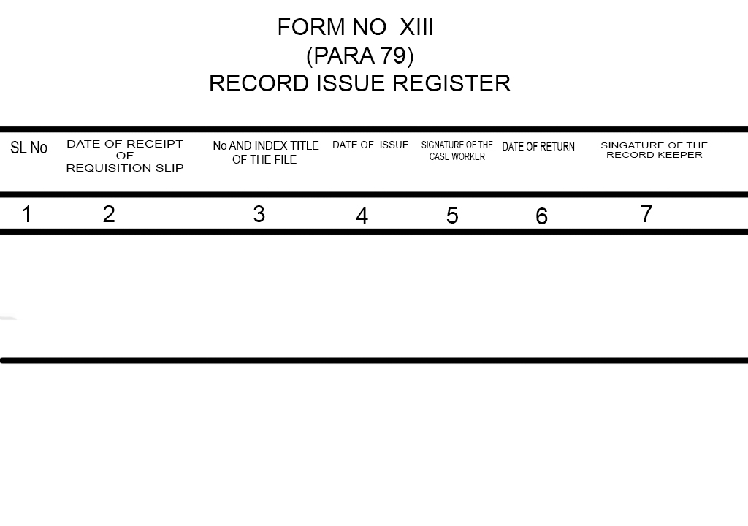

Slide 27
Thank you

